Slide 1
William Stallings
Computer Organization and Architecture
7th Edition
Chapter 6
External Memory

Slide 2
Types of External Memory
Magnetic Disk
  RAID
  Removable
Optical
  CD-ROM
  CD-Recordable (CD-R)
  CD-R/W
  DVD
Magnetic Tape

Slide 3
Magnetic Disk
Disk substrate coated with magnetizable material (iron oxide…rust)
Substrate used to be aluminium
Now glass
  Improved surface uniformityتم تطويرها الى واجهات
    Increases reliability
  Reduction in surface defects
    Reduced read/write errors
  Lower flight heights (See later)
  Better stiffness
  Better shock/damage resistance

Slide 4
Read and Write Mechanisms
Recording & retrieval via conductive coil called a head
تسجيل واسترجاع بواسطه موصل يسمى الهيدر
May be single read/write head or separate ones
قد تكون القراءه واكتابه بهيدر واحد او هيدر لكل واحد
During read/write, head is stationary, platter rotates
اثناء القراءه والكتابه الهيدر ممكن يكون ثابه او متنقل (متناوب)بين الصحون
Writeاالكتابه
  Current through coil produces magnetic fieldتيار الملف ينتج مجال مغناطسى
  Pulses sent to headارسال النبضات الى الهيدر
  Magnetic pattern recorded on surface below
Read (traditional)القراءه التقليديه
  Magnetic field moving relative to coil produces current
  Coil is the same for read and write
Read (contemporary)القراء المعاصره
  Separate read head, close to write head
  Partially shielded magneto resistive (MR) sensor
  Electrical resistance depends on direction of magnetic field
  High frequency operation
    Higher storage density and speed زياده كثافه التخذيين والسرعه

Slide 5
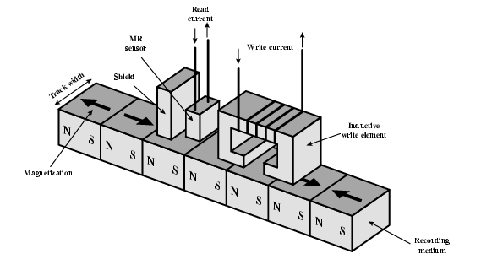
Inductive Write MR Read

Slide 6
Data Organization and Formatting
تنظيم البينات داخل القرص والتهيئه
Concentric rings or tracksالمسارات والتراكات متحده المركز
  Gaps between tracksتوجد قابات بين كل تراك
  Reduce gap to increase capacity
  تقليل القابات يزيد من السعه
  Same number of bits per track (variable packing density)
  Constant angular velocity
Tracks divided into sectorsاى تراك يقسم الى سكتر
Minimum block size is one sector
اصغر بلوك هو سكتر واحد
May have more than one sector per block
يمكن ان يكون هنالك اكثر من سكتر فى البلوك الواحد

Slide 7
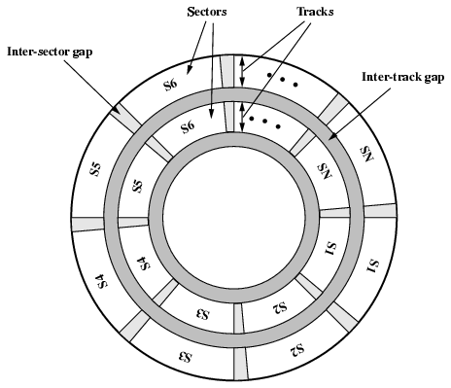
Disk Data Layout

Slide 8
Disk Velocity سرعه الدسك
Bit near centre of rotating disk passes fixed point slower than bit on outside of disk
Increase spacing between bits in different tracks
Rotate disk at constant angular velocity (CAV)
  Gives pie shaped sectors and concentric tracks
  Individual tracks and sectors addressable
  Move head to given track and wait for given sector
  Waste of space on outer tracks
    Lower data density
Can use zones to increase capacity
  Each zone has fixed bits per track
  More complex circuitry

Slide 9
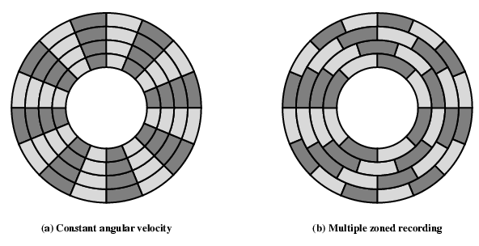
Disk Layout Methods Diagram

Slide 10
Finding Sectors
Must be able to identify start of track and sector
Format disk
  Additional information not available to user
  Marks tracks and sectors

Slide 11
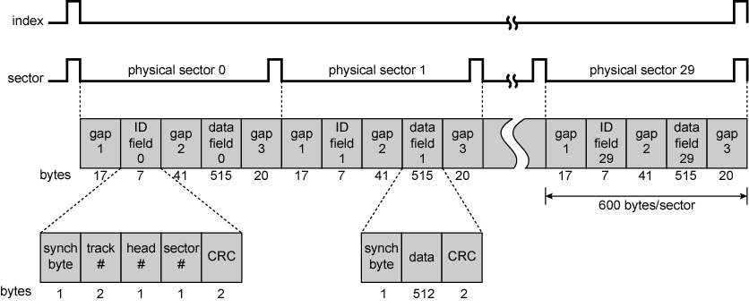
Winchester Disk Format
Seagate ST506

Slide 12
Characteristics
Fixed (rare) or movable head
Removable or fixed
Single or double (usually) sided
Single or multiple platter
Head mechanism
  Contact (Floppy)
  Fixed gap
  Flying (Winchester)

Slide 13
Fixed/Movable Head Disk
Fixed head
  One read write head per track
  Heads mounted on fixed ridged arm
Movable head
  One read write head per side
  Mounted on a movable arm

Slide 14
Removable or Not
Removable disk
  Can be removed from drive and replaced with another disk
  Provides unlimited storage capacity
  Easy data transfer between systems
Nonremovable disk
  Permanently mounted in the drive

Slide 15
Multiple Platter
One head per side
Aligned tracks on each platter form cylinders
Data is striped by cylinder
  reduces head movement
  Increases speed (transfer rate)

Slide 16
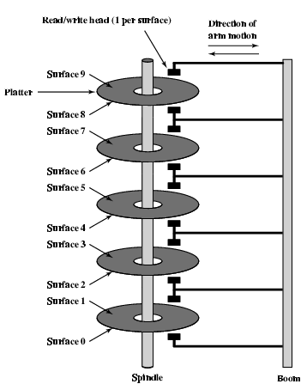
Multiple Platters

Slide 17
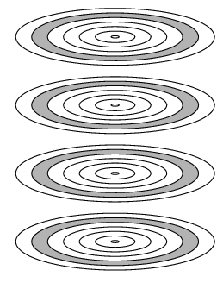
Tracks and Cylinders

Slide 18
Floppy Disk
8”, 5.25”, 3.5”
Small capacity
  Up to 1.44Mbyte (2.88M never popular)
Slow
Universal رخيصه
Cheap

Slide 19
Winchester Hard Disk (1)
Developed by IBM in Winchester (USA)
Sealed unit
One or more platters (disks)
Very small head to disk gap

Slide 20
Winchester Hard Disk (2)
Universal
Cheap
Fastest external storage
Getting larger all the time
  250 Gigabyte now easily available

Slide 21
Speed
Seek time
  Moving head to correct track
(Rotational) latency
  Waiting for data to rotate under head
Access time = Seek + Latency
Transfer rate

Slide 22
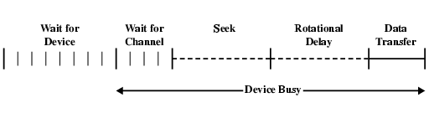
Timing of Disk I/O Transfer

Slide 23
RAID
Redundant Array of Independent Disks
Redundant Array of Inexpensive Disks
6 levels in common use
Not a hierarchy
Set of physical disks viewed as single logical drive by O/S
Data distributed across physical drives
Can use redundant capacity to store information

Slide 24
RAID 0
No redundancy
Data striped across all disks
Round Robin striping
Increase speed
  Multiple data requests probably not on same disk
  Disks seek in parallel
  A set of data is likely to be striped across multiple disks
  مجموعه البيانات تتوزع عى جميع الدسكات

Slide 25
RAID 1
Mirrored Disks
Data is striped across disks
2 copies of each stripe on separate disks
Read from eitherسريع فى القراءه
Write to bothبطى فى الكتابه
Recovery is simple
Expensive

Slide 26
RAID 2
Disks are synchronized
Very small stripes
  Often single byte/word
Error correction calculated across corresponding bits on disks
Lots of redundancy
  Expensive
  Not used

Slide 27
RAID 3
Similar to RAID 2
Only one redundant disk, no matter how large the array
Simple parity bit for each set of corresponding bits
Data on failed drive can be reconstructed from surviving data and parity info
Very high transfer rates

Slide 28
RAID 4
Each disk operates independently
Good for high I/O request rate
Large stripes
Bit by bit parity calculated across stripes on each disk

Slide 29
RAID 5
Like RAID 4
Parity striped across all disks
Round robin allocation for parity stripe
Avoids RAID 4 bottleneck at parity disk
Commonly used in network servers
N.B. DOES NOT MEAN 5 DISKS!!!!!

Slide 30
RAID 6
Two parity calculations
Stored in separate blocks on different disks
User requirement of N disks needs N+2
High data availability

Slide 31
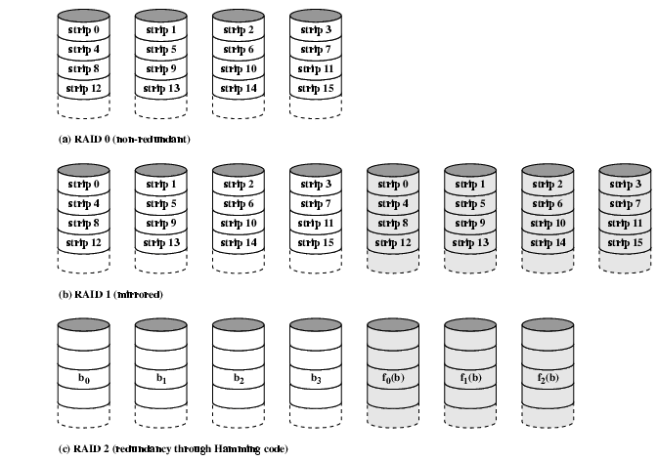
RAID 0, 1, 2

Slide 32
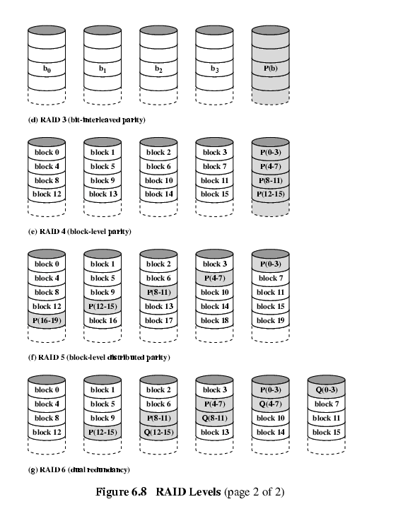
RAID 3 & 4

Slide 33
RAID 5 & 6

Slide 34
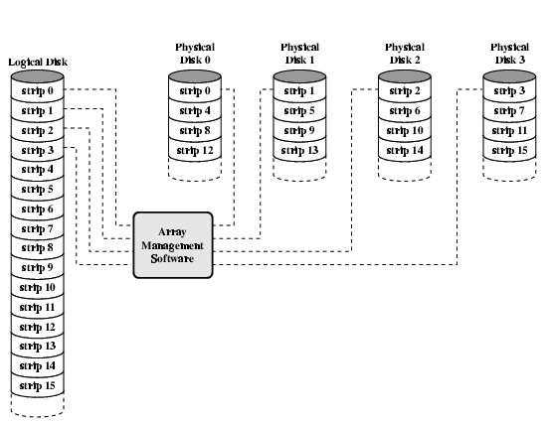
Data Mapping For RAID 0

Slide 35
Optical Storage CD-ROM
Originally for audio
650Mbytes giving over 70 minutes audio
Polycarbonate coated with highly reflective coat, usually aluminium
Data stored as pits
Read by reflecting laser
Constant packing density
Constant linear velocity

Slide 36
CD-ROM Drive Speeds
Audio is single speed
Other speeds are quoted as multiples
Quoted figure is maximum drive can achieve

Slide 37
Random Access on CD-ROM
Difficult
Move head to rough position
Set correct speed
Read address
Adjust to required location
(Yawn!)

Slide 38
CD-ROM for & against
Large capacity (?)
Easy to mass produce
Removable
Expensive for small runs
Slow
Read only

Slide 39
Other Optical Storage
CD-Recordable (CD-R)
  WORM
  Compatible with CD-ROM drives
CD-RW
  Erasable
  Getting cheaper
  Mostly CD-ROM drive compatible
  Phase change

Slide 40
DVD - what’s in a name?
Digital Video Disk
  Used to indicate a player for movies
    Only plays video disks
Digital Versatile Disk
  Used to indicate a computer drive
    Will read computer disks and play video disks
Dogs Veritable Dinner

Slide 41
DVD - technology
Multi-layer
Very high capacity (4.7G per layer)
Full length movie on single disk
Finally standardized (honest!)
Movies carry regional coding
Players only play correct region films
Can be “fixed”

Slide 42
DVD – Writable
Loads of trouble with standards
First generation DVD drives may not read first generation DVD-W disks
First generation DVD drives may not read CD-RW disks
Wait for it to settle down before buying!

Slide 43
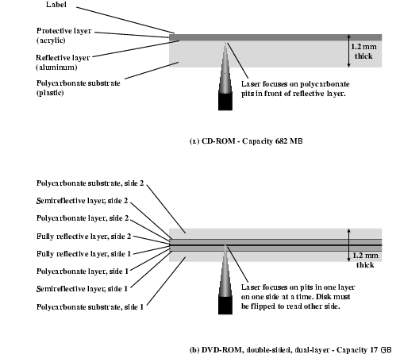
CD and DVD

Slide 44
Magnetic Tape
Serial access
Slow
Very cheap
Backup and archive

